Slide 1

Introducing {workboots}
Generate prediction intervals from tidymodel workflows
Mark Rieke
2022-07-27
<link to slides>

Slide 2


Slide 3
paint brush with bluetooth

Slide 4
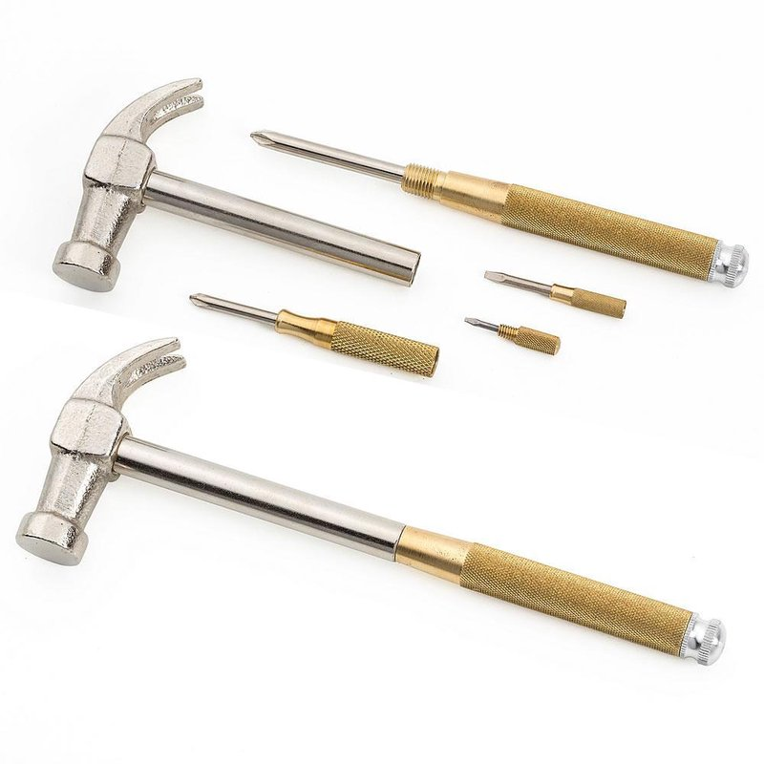

Slide 5
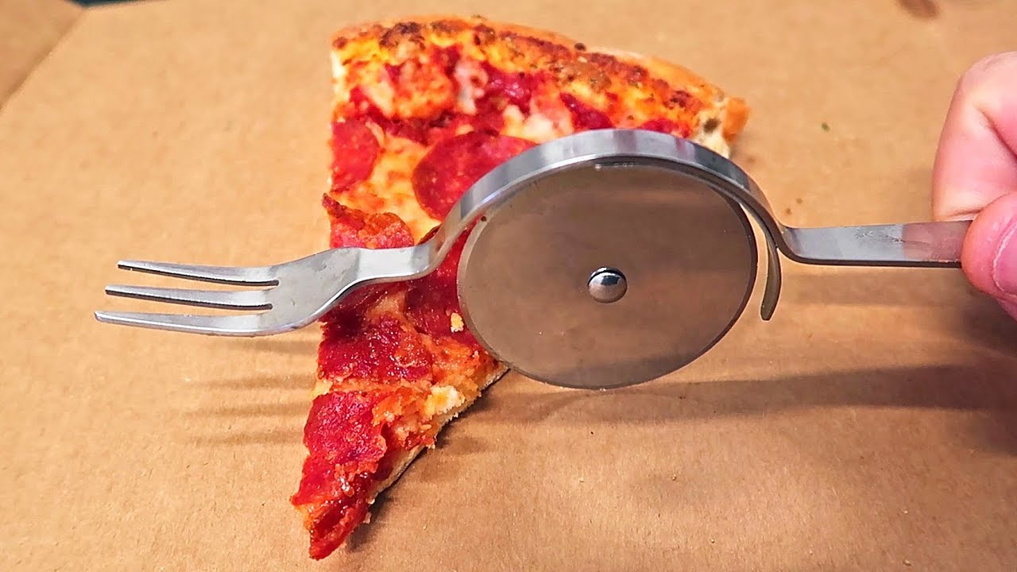

Slide 6
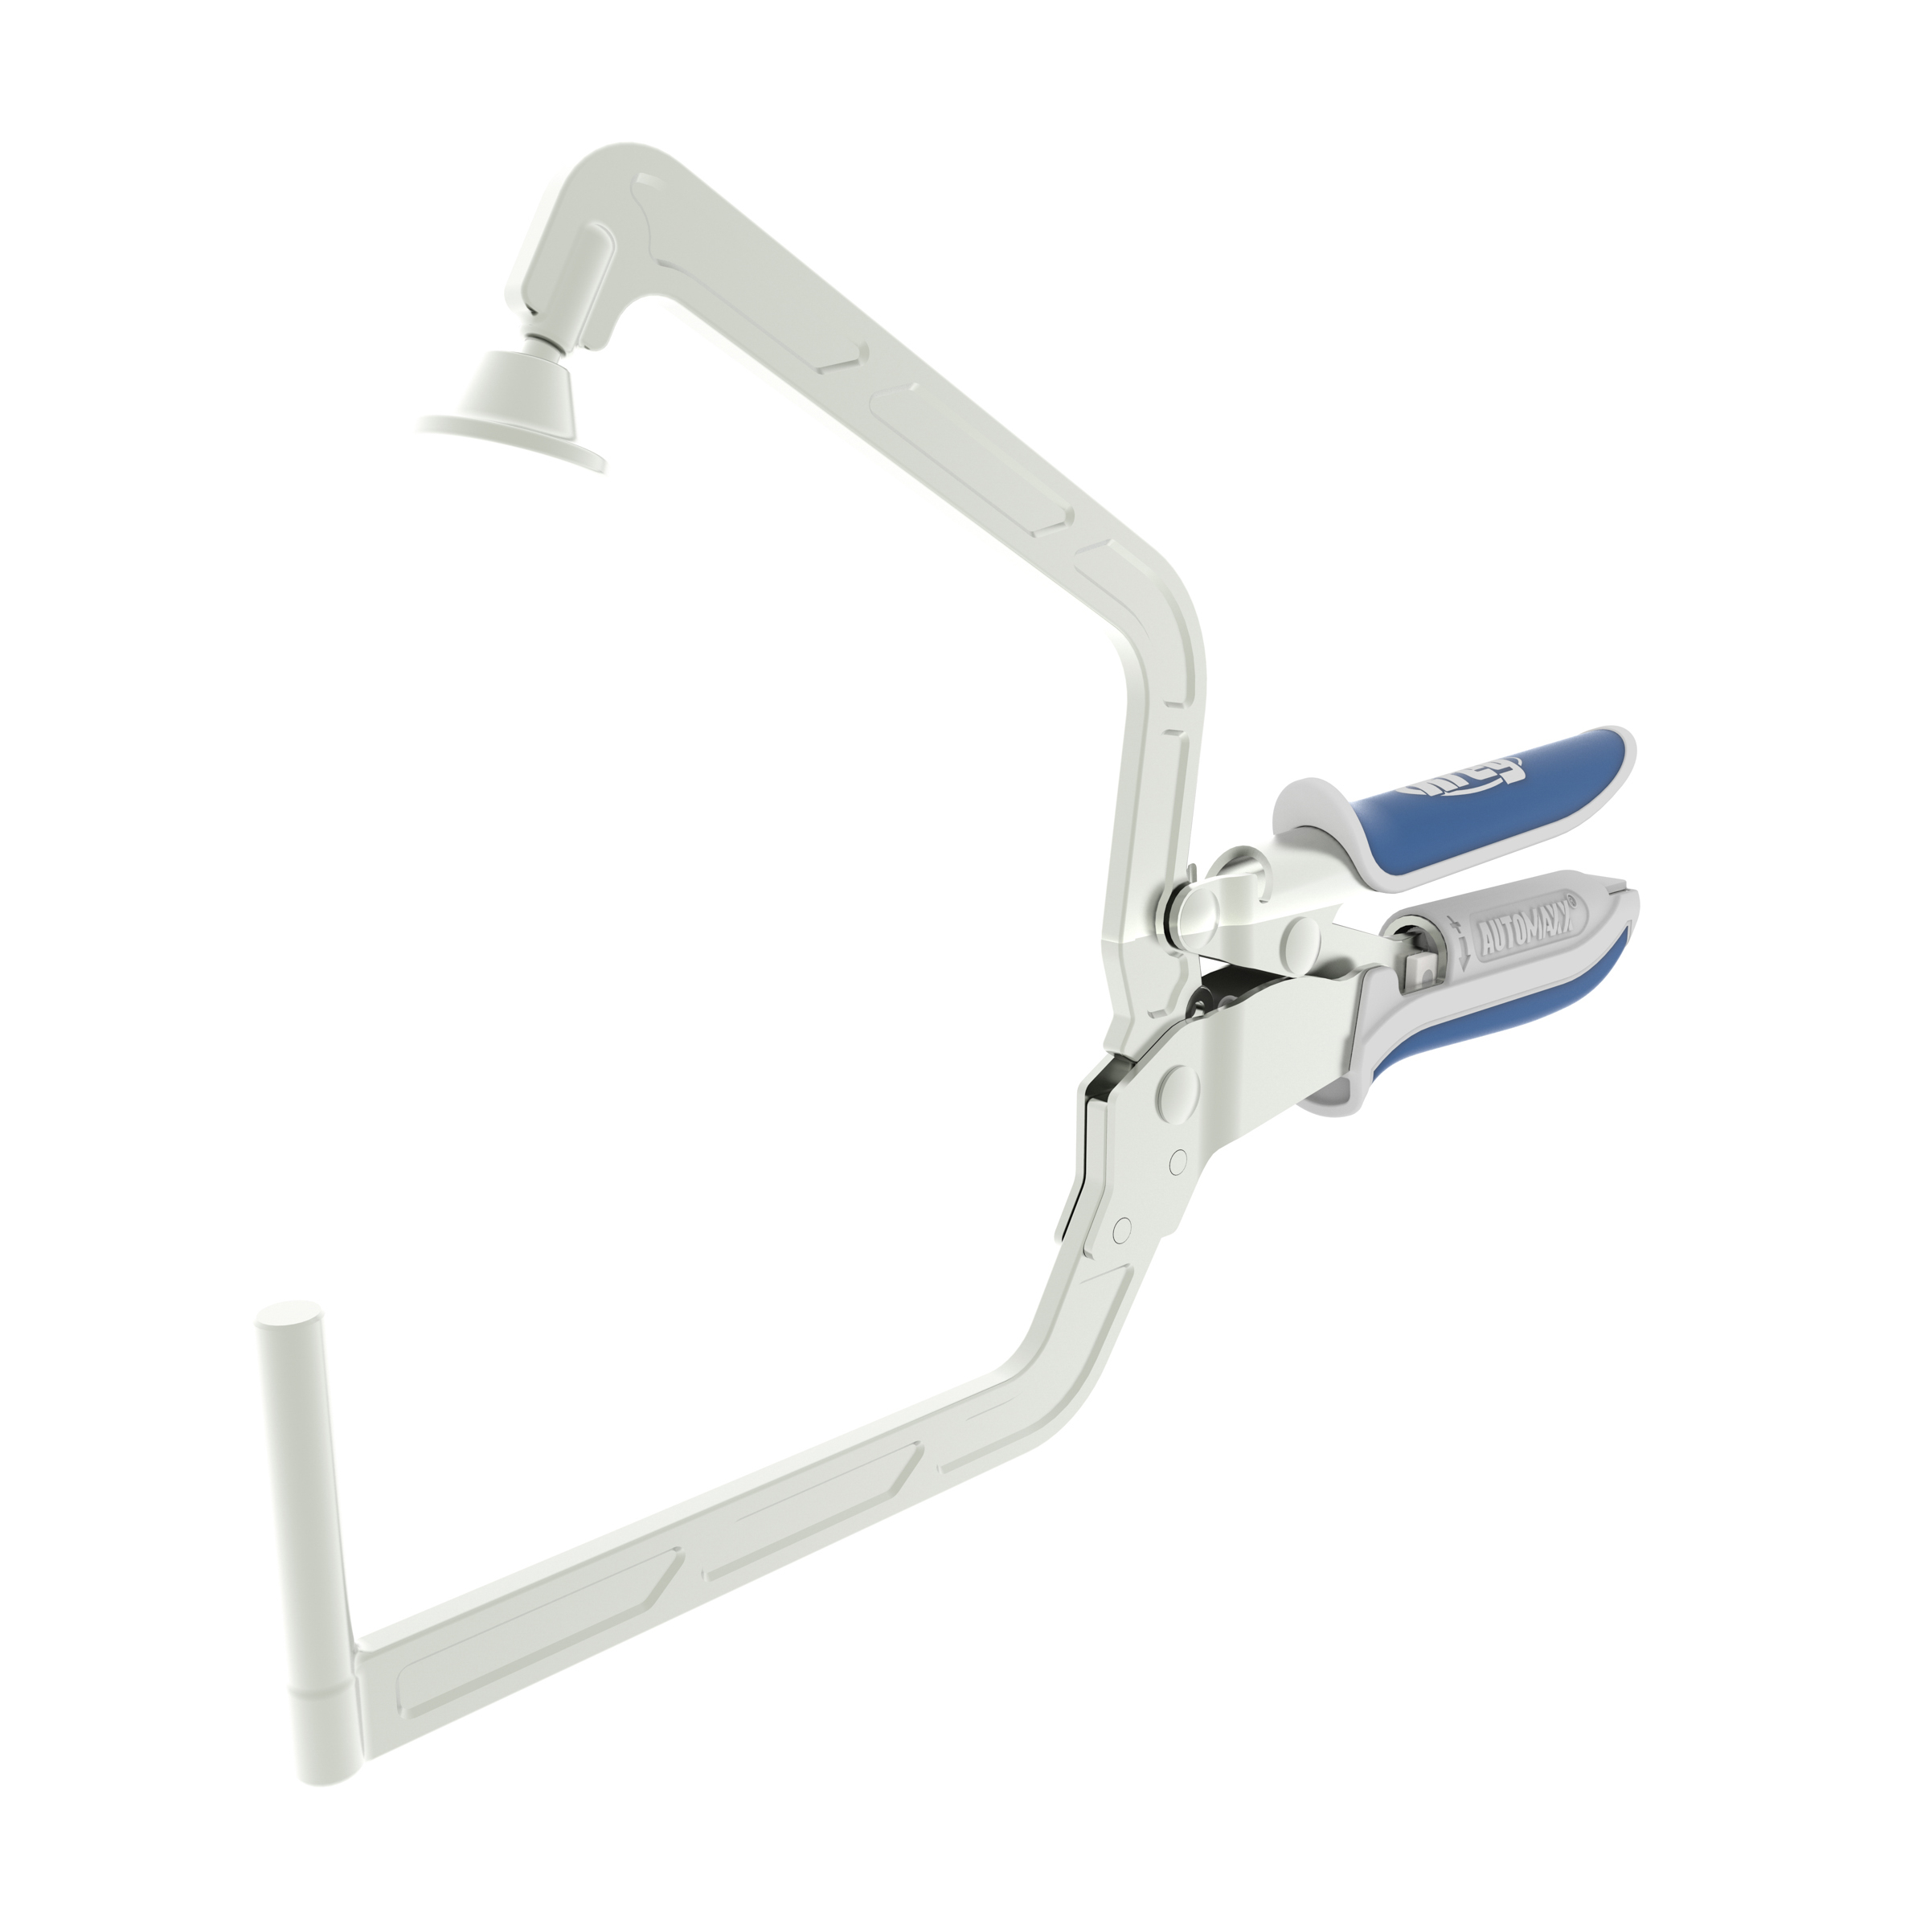
Update with mine later

Slide 7
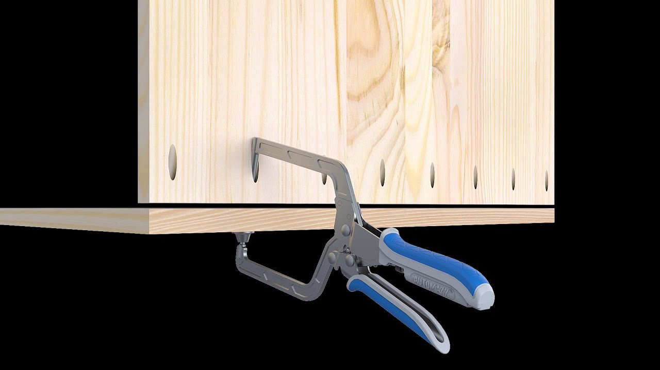
Update with mine later

Slide 8
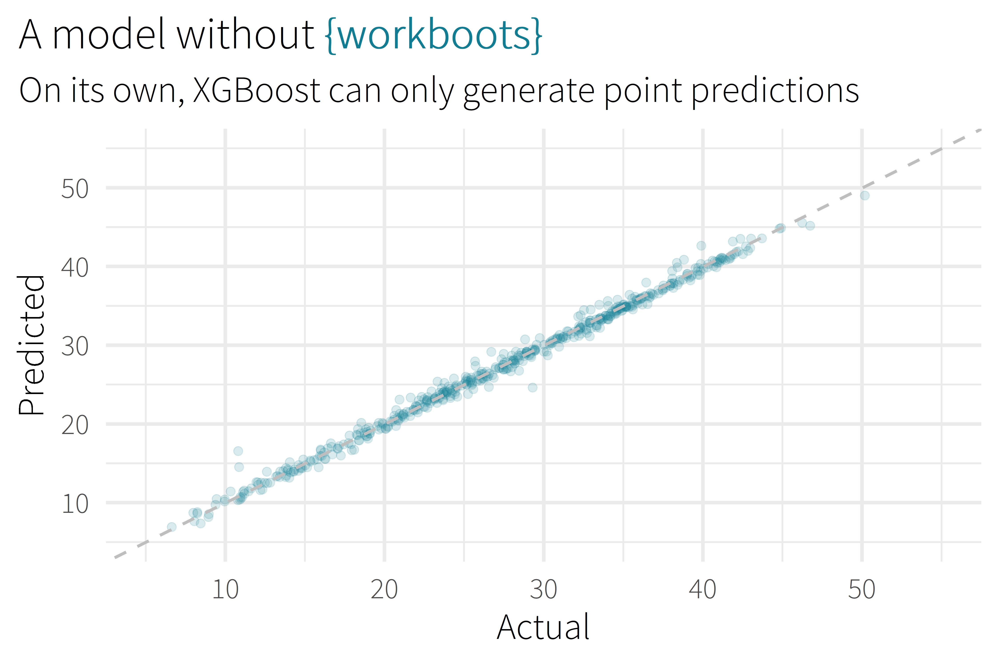

Slide 9
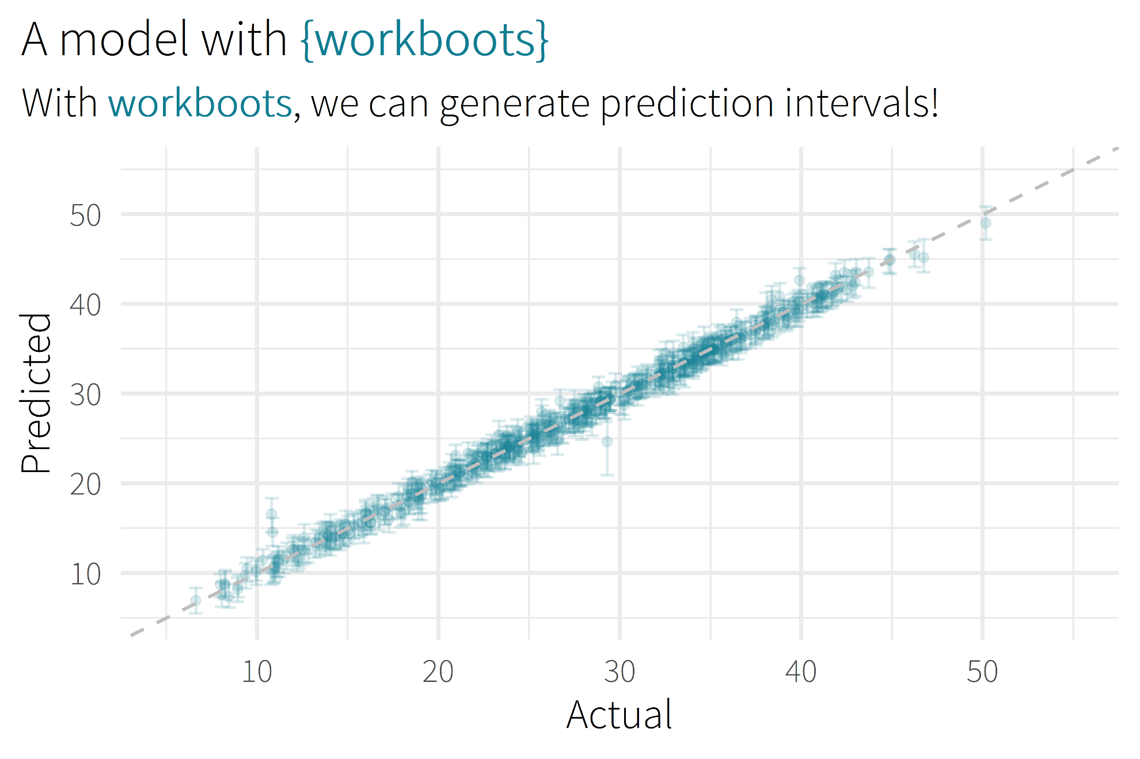

Slide 10

Motivation/Background

Slide 11
background
Why you might want to use? (role as analyst)
Checks to hit before use

Slide 12
Package Overview

Slide 13
“how this works” section
where workboots sits in the model timeline
High-level review of bootstrapping
High-level review of methodology (train a bunch of models to get a bunch of possible outcomes)

Slide 14
using workboots
Set up a workflow
Generate predictions
Summarise results

Slide 15
set up a workflow
library(tidymodels)

Slide 16
set up a workflow
library(tidymodels)
# setup our data
data(“penguins”)
penguins <- penguins %>% drop_na()

Slide 17
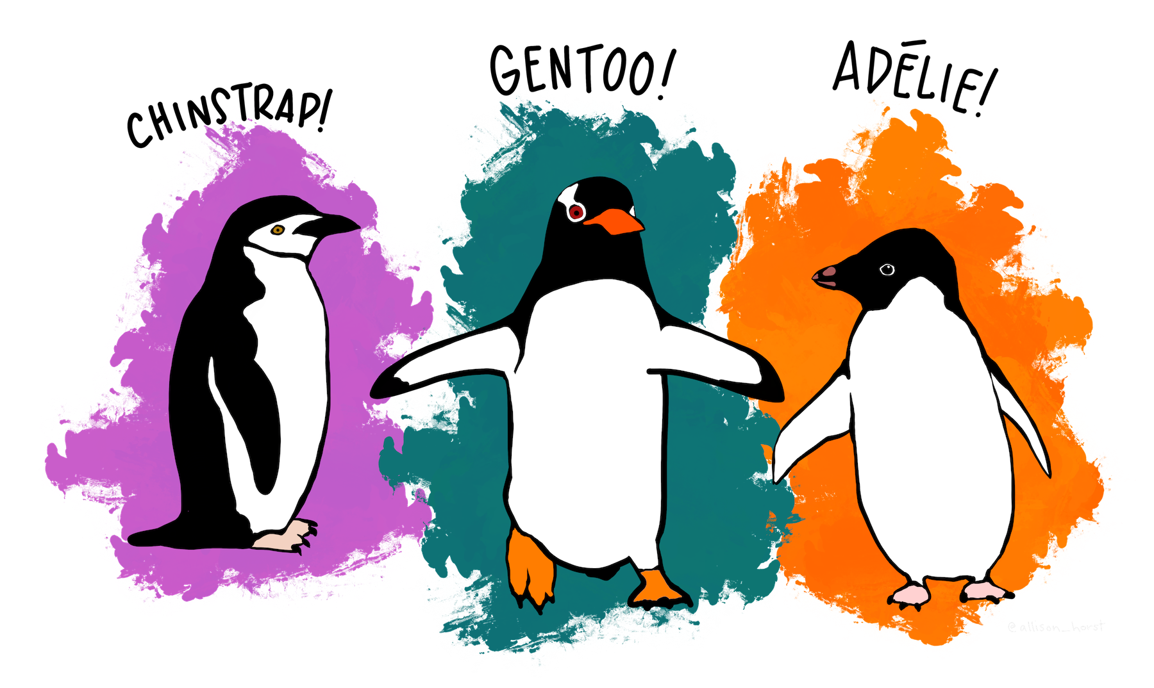
set up a workflow
library(tidymodels)
# setup our data
data(“penguins”)
penguins <- penguins %>% drop_na()

Slide 18
Throw in a quick snapshot of the penguins dataset (eg, console output of penguins)

Slide 19
set up a workflow
library(tidymodels)
# setup our data
data(“penguins”)
penguins <- penguins %>% drop_na()
set.seed(123)
penguins_split <- initial_split(penguins)
penguins_test <- testing(penguins_split)
penguins_train <- training(penguins_split)

Slide 20
set up a workflow
# setup a basic preprocessing recipe
penguins_rec <-
recipe(body_mass_g ~ ., data = penguins_train) %>%
step_dummy(all_nominal())

Slide 21
set up a workflow
# setup a basic preprocessing recipe
penguins_rec <-
recipe(body_mass_g ~ ., data = penguins_train) %>%
step_dummy(all_nominal())
# put together a workflow
penguins_wf <-
workflow() %>%
add_recipe(penguins_rec) %>%
add_model(boost_tree(“regression”))
Notes:
Notes
All tuning parameters finalized (in this case, we’re just using the defaults)
Workflow hasn’t been fit

Slide 22
generate predictions
library(workboots)

Slide 23

generate predictions
library(workboots)

Slide 24
generate predictions
library(workboots)
# generate a bootstrap prediction interval
set.seed(345)
penguins_preds <-
penguins_wf %>%
predict_boots(
n = 2000,
training_data = penguins_train,
new_data = penguins_test,
interval = “prediction”
)

Slide 25
generate predictions
library(workboots)
# generate a bootstrap prediction interval
set.seed(345)
penguins_preds <-
penguins_wf %>%
predict_boots(
n = 2000,
training_data = penguins_train,
new_data = penguins_test,
interval = “prediction”
)
Notes:
Number of bootstrap predictions to make

Slide 26
generate predictions
library(workboots)
# generate a bootstrap prediction interval
set.seed(345)
penguins_preds <-
penguins_wf %>%
predict_boots(
n = 2000,
training_data = penguins_train,
new_data = penguins_test,
interval = “prediction”
)
Notes:
Supply both our training data and new data in one step, since we’ll be fitting and predicting with one function call

Slide 27
generate predictions
library(workboots)
# generate a bootstrap prediction interval
set.seed(345)
penguins_preds <-
penguins_wf %>%
predict_boots(
n = 2000,
training_data = penguins_train,
new_data = penguins_test,
interval = “prediction”
)
Notes:
Supply both our training data and new data in one step, since we’ll be fitting and predicting with one function call

Slide 28
generate predictions
penguins_preds
#> # A tibble: 84 x 5
#> rowid .preds
#> <int> <list>
#> 1 1 <tibble [2,000 x 2]>
#> 2 2 <tibble [2,000 x 2]>
#> 3 3 <tibble [2,000 x 2]>
#> 4 4 <tibble [2,000 x 2]>
#> 5 5 <tibble [2,000 x 2]>
#> # ... With 79 more rows
Notes:
Returns a tibble with 2000 nested predictions for each observation. In this case, each row represents a penguin in the penguins_test dataset.

Slide 29
summarise results
penguins_preds %>%
summarise_predictions() %>% select(-.preds)
#> # A tibble: 84 x 5
#> rowid .pred .pred_lower .pred_upper
#> <int> <dbl> <dbl> <dbl>
#> 1 1 3465. 2913. 3994.
#> 2 2 3535. 2982. 4100.
#> 3 3 3604. 3050. 4187.
#> 4 4 4157. 3477. 4764.
#> 5 5 3868. 3305. 4372.
#> # ... With 79 more rows
Notes:
Can pass this to summarise_predictions(), which appends each prediction with the median, upper and lower interval bounds.

Slide 30
generate predictions
library(workboots)
# generate a bootstrap prediction interval
set.seed(345)
penguins_preds <-
penguins_wf %>%
predict_boots(
n = 2000,
training_data = penguins_train,
new_data = penguins_test,
interval = “prediction”
)

Slide 31
generate predictions
library(workboots)
# generate a bootstrap prediction interval
set.seed(345)
penguins_preds <-
penguins_wf %>%
predict_boots(
n = 2000,
training_data = penguins_train,
new_data = penguins_test,
interval = “prediction”
)
Notes:
By default, predict_boots() will generate a prediction interval

Slide 32
generate predictions
library(workboots)
# generate a bootstrap prediction interval
set.seed(345)
penguins_preds <-
penguins_wf %>%
predict_boots(
n = 2000,
training_data = penguins_train,
new_data = penguins_test,
interval = “confidence”
)
Notes:
But we can also generate

Slide 33
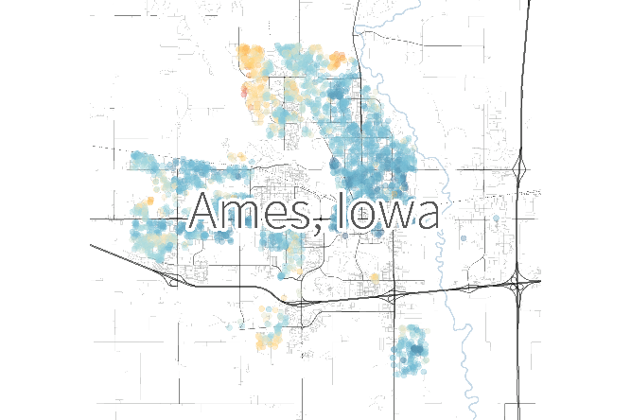
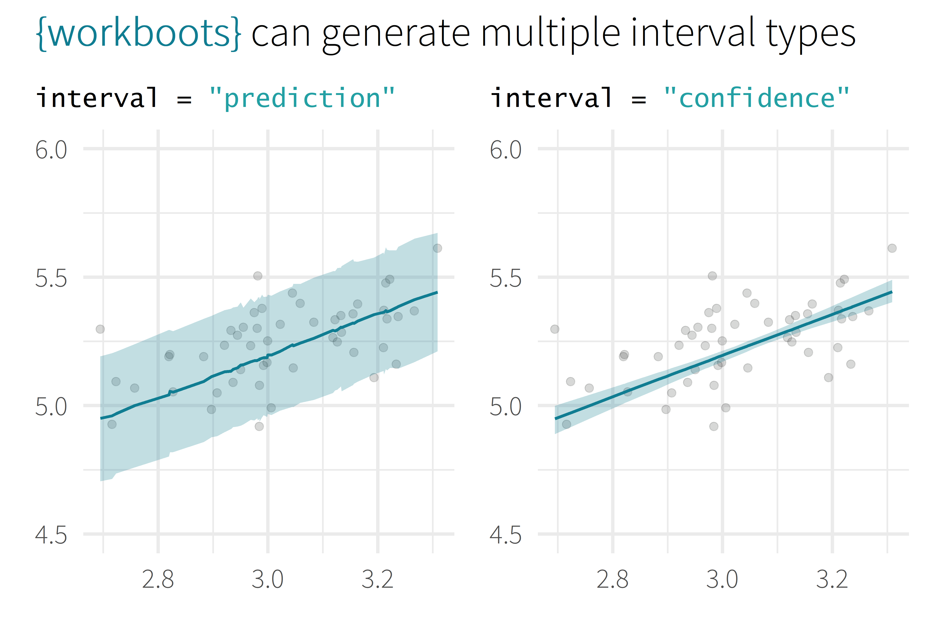
Remember to give a description of Ames dataset:
Predicting the price of a home’s sale price in Ames, Iowa
log10(Sale_Price)
log10(First_Flr_SF)

Slide 34
generate importances
# generate a bootstrap variable importances
set.seed(345)
penguins_vi <-
penguins_wf %>%
vi_boots(
n = 2000,
training_data = penguins_train
)
Remind people what feature importance is:
Methods of measuring feature importance vary depending on model type
More important features have a greater impact on the model’s prediction

Slide 35
generate importances
penguins_vi
#> # A tibble: 8 x 2
#> variable .importances
#> <int> <list>
#> 1 flipper_length_mm <vi [2,000 x 2]>
#> 2 species_Gentoo <vi [1,928 x 2]>
#> 3 bill_length_mm <vi [2,000 x 2]>
#> 4 bill_depth_mm <vi [2,000 x 2]>
#> 5 sex_male <vi [2,000 x 2]>
#> # ... With 3 more rows

Slide 36
summarise importances
penguins_vi %>%
summarise_importance() %>% select(-.importances)
#> # A tibble: 8 x 2
#> variable .importance .importance_lower
#> <int> <dbl> <dbl>
#> 1 flipper_length_mm 0.464 0.254
#> 2 species_Gentoo 0.402 0.044
#> 3 bill_length_mm 0.045 0.027
#> 4 bill_depth_mm 0.040 0.024
#> 5 sex_male 0.046 0.020
#> # ... With 3 more rows, and 1 more variable:
#> # .importance_upper <dbl>

Slide 37
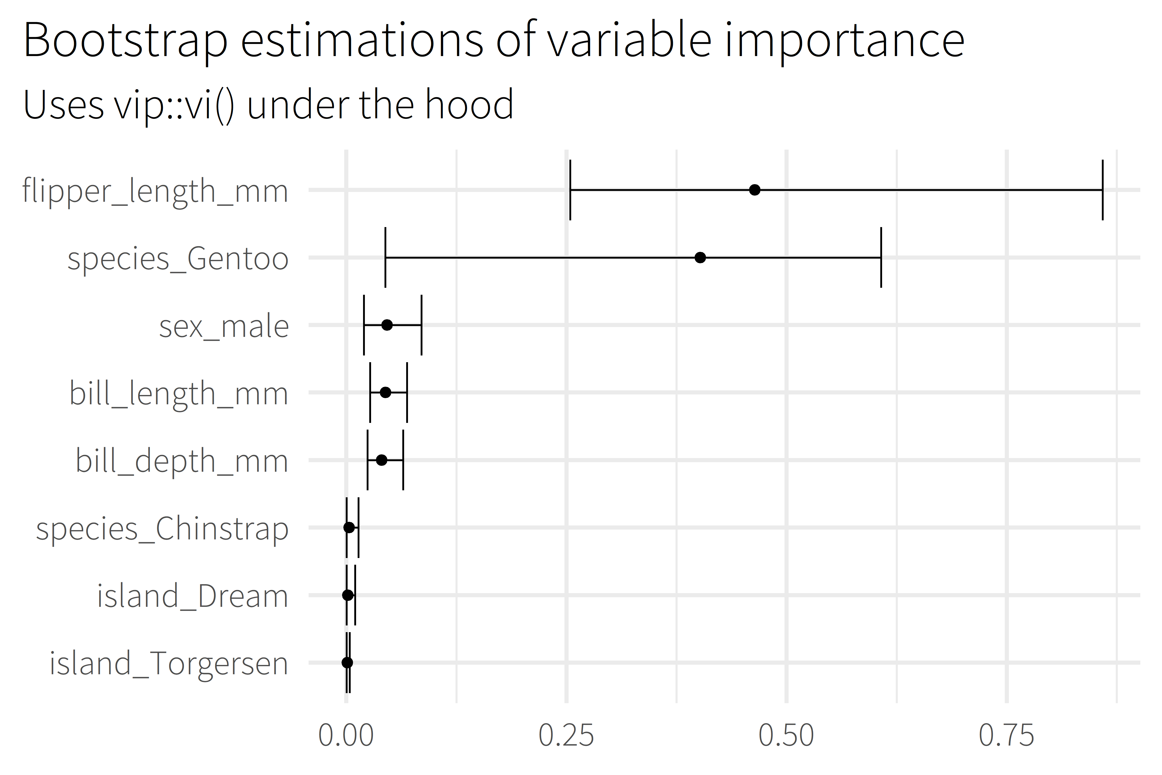
Talk about the features themselves, e.g.,
According to this model, the length of a penguin’s flipper is way more important to figuring out their weight than which island the penguin comes from
Notes:
Uses the vip package under the hood to estimate model-specific importance.
Some model types aren’t supported by vip

Slide 38
Call to action (use my package plz)
Closing
Links, acknowledgements, resources

Slide 39
Backup

Slide 40
overview
Selling Point
About me
Motivation / Background
Package overview
Cost of doing business
(1 min)
(2 min)
(5 min)
(5 min)
(5 min)

Slide 41








about me
BSME, University of Tulsa
Sr. CX Analyst, MHHS
@markjrieke

Slide 42
“I use R and tidymodels to provide actionable insight from patient survey data.”

Slide 43
plot/plot/plot

Slide 44
plot/plot/plot
context/context/context

Slide 45

5.0 (19)
4.6 (2,280)

Slide 46
What is the range of possible outcomes?
How important is each variable in the model?

Slide 47

lm()
me
XGBoost

Slide 48
Prediction Intervals

Slide 49
Prediction Intervals
Powerful Models

Slide 50
Prediction Intervals
{workboots}
Powerful Models

Slide 51
Prediction Intervals
{workboots}
Powerful Models
via bootstrap resampling

